Slide 1
CINEMAFICA
Home
About me
What I do
My experience
My work
Iniciar apresentação

Slide 2
EQUIPE
Home
About me
What I do
My experience
My work
Ana Cristina
Kenia Teixeira
Letícia Azevedo
Manoella Santos

Slide 3
Especificações Funcionais
Home
About me
What I do
My experience
My work
01

Slide 4
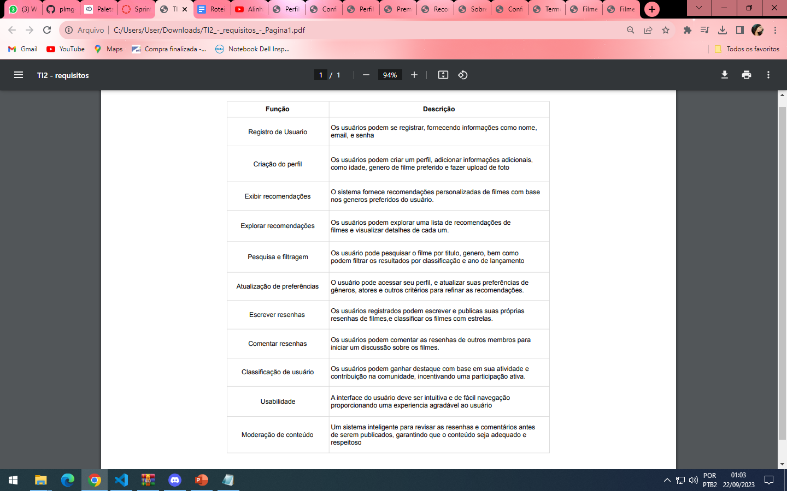
Home
About me
What I do
My experience
My work

Slide 5
Diagrama Entidade-Relacionamento (DER) em notação Peter Chen
Home
About me
What I do
My experience
My work
02

Slide 6
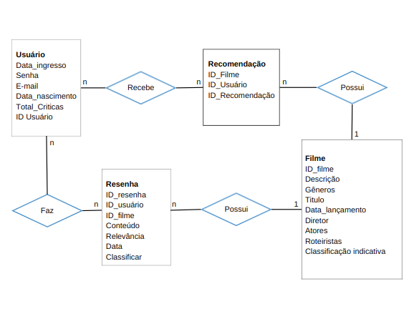
Home
About me
What I do
My experience
My work

Slide 7
01
Diagrama de Esquema (DSC) em notação Elmasri & Navathe
Home
About me
What I do
My experience
My work
03

Slide 8
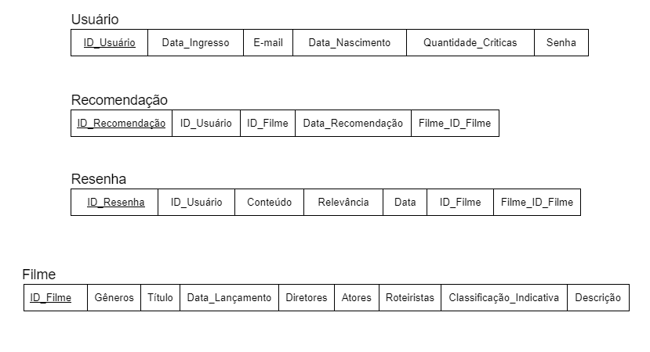
Home
About me
What I do
My experience
My work

Slide 9
Home
About me
What I do
My experience
My work
04
Diagrama Entidade-Relacionamento Estendido em notação Pé de Galinha

Slide 10
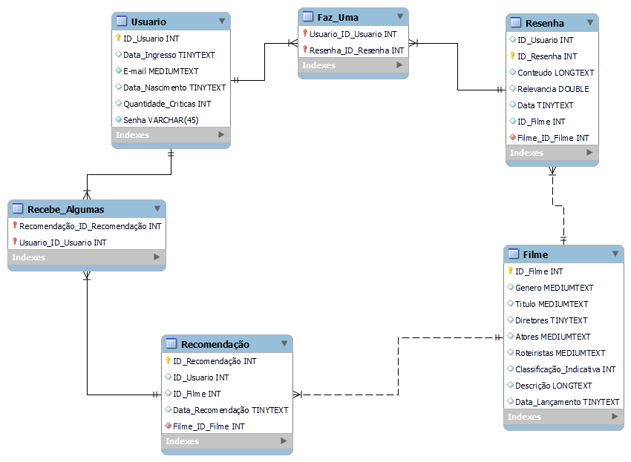
Home
About me
What I do
My experience
My work

Slide 11
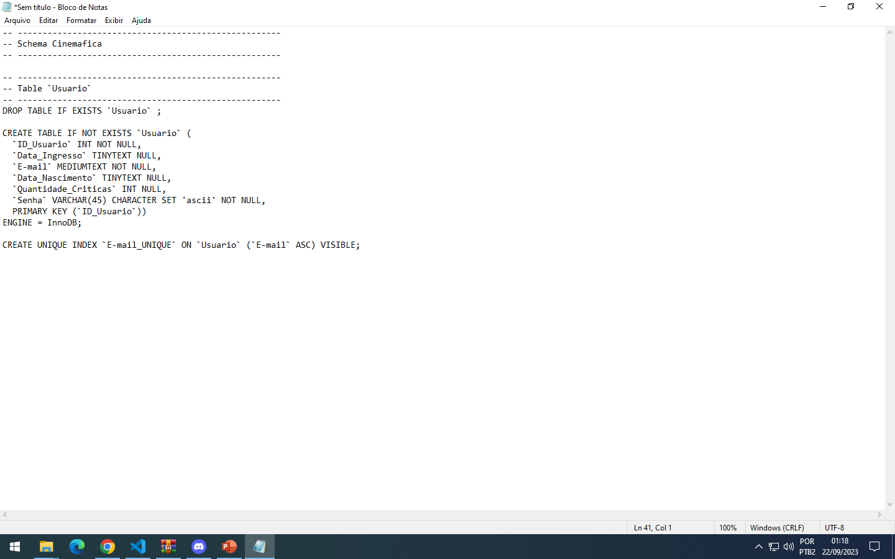
IMPLEMENTAÇÃO
Home
About me
What I do
My experience
My work
-Criação do esquema
-Tabelas
-Restições do Banco de Dados

Slide 12
FRONTEND
Home
About me
What I do
My experience
My work
05

Slide 13
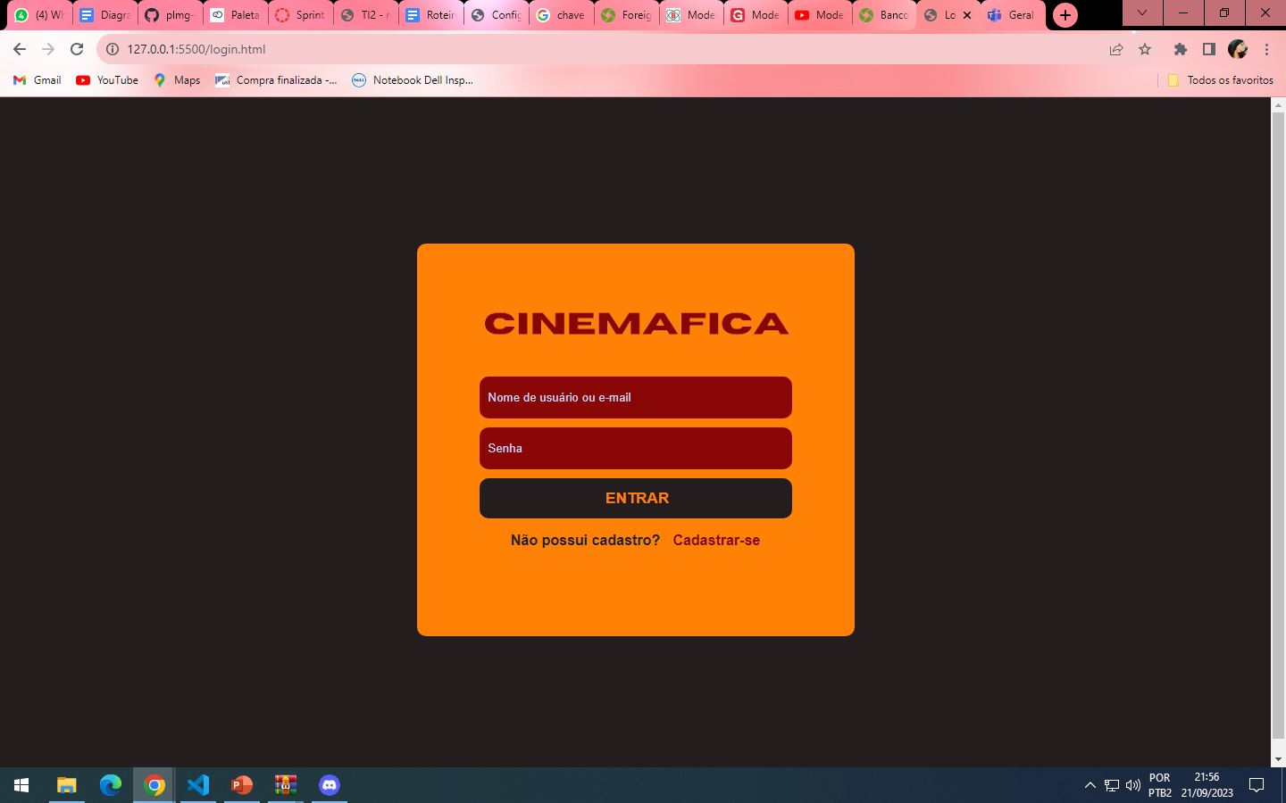
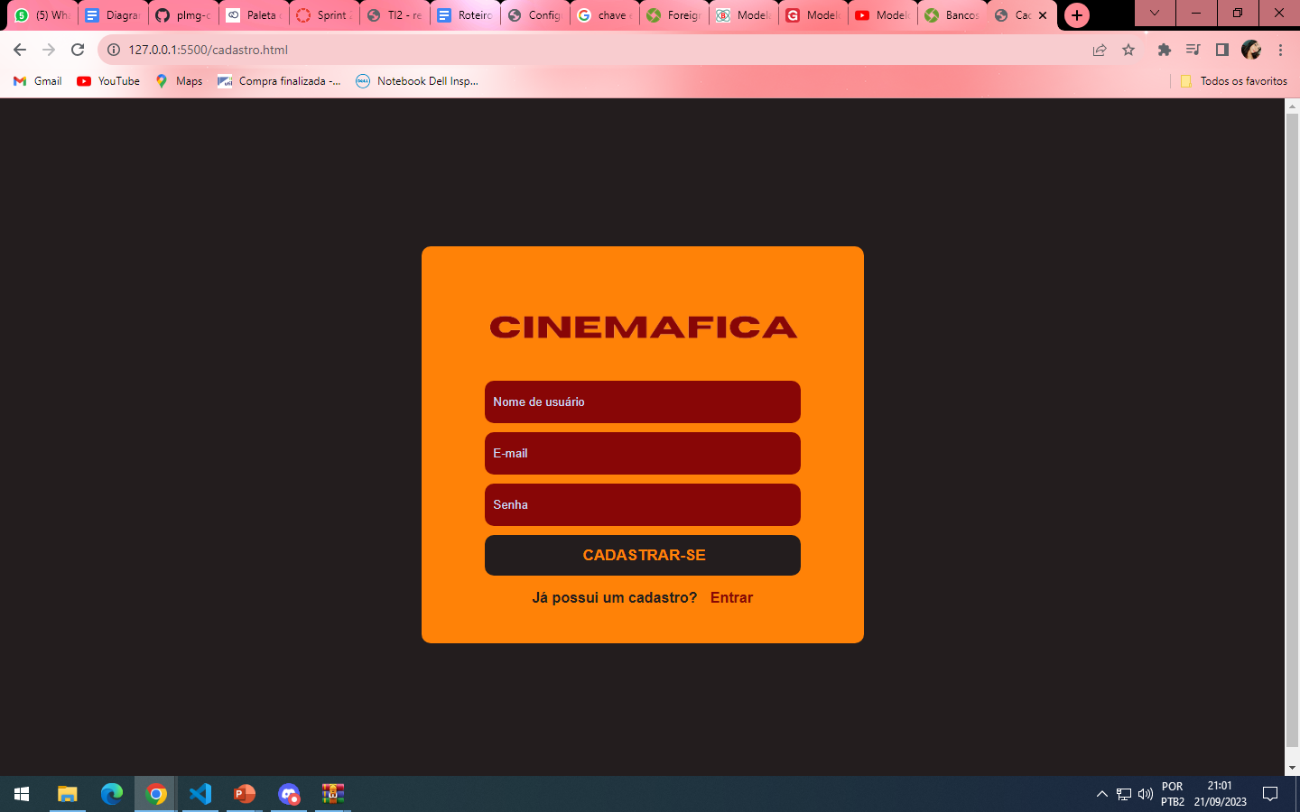
Home
About me
What I do
My experience
My work

Slide 14
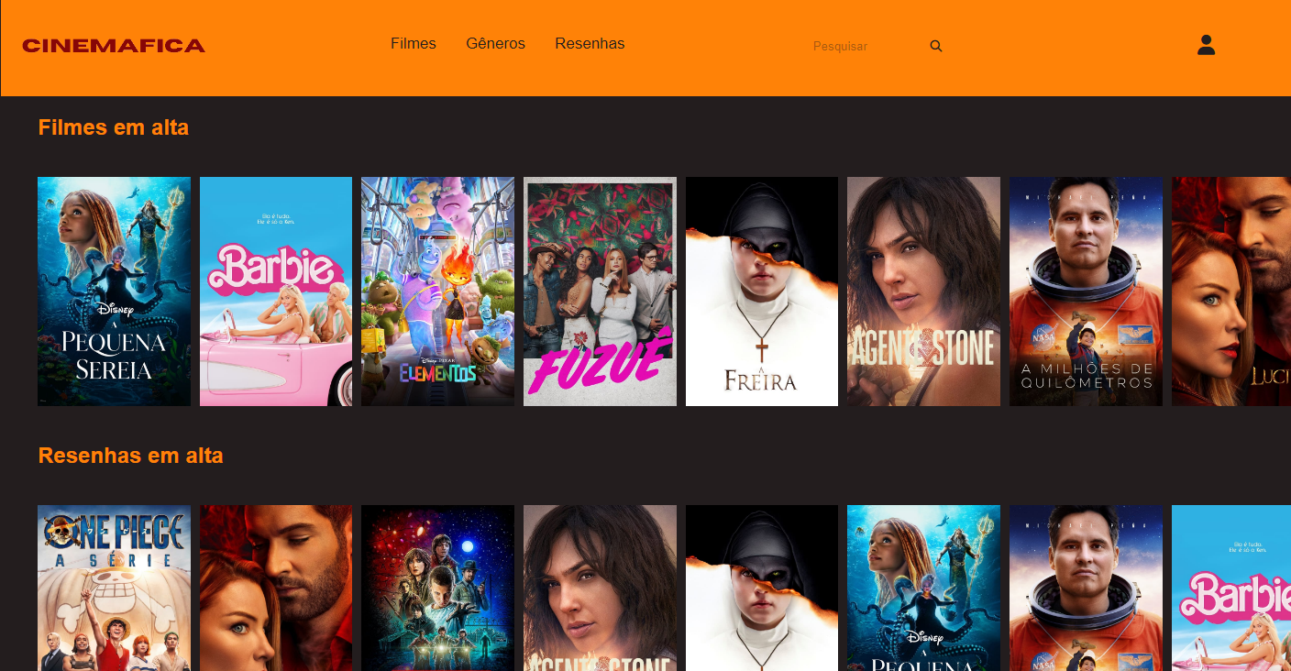
Home
About me
What I do
My experience
My work

Slide 15
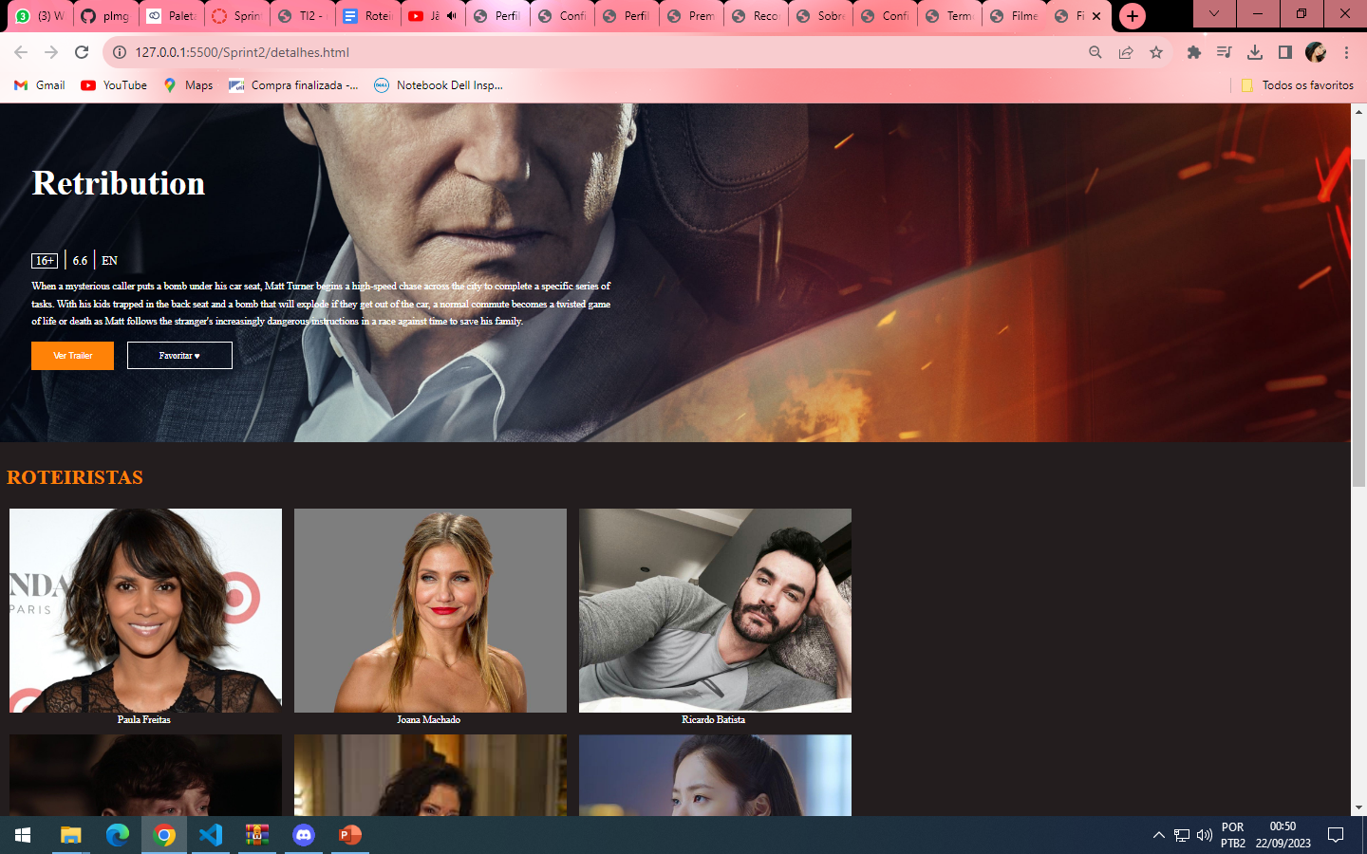
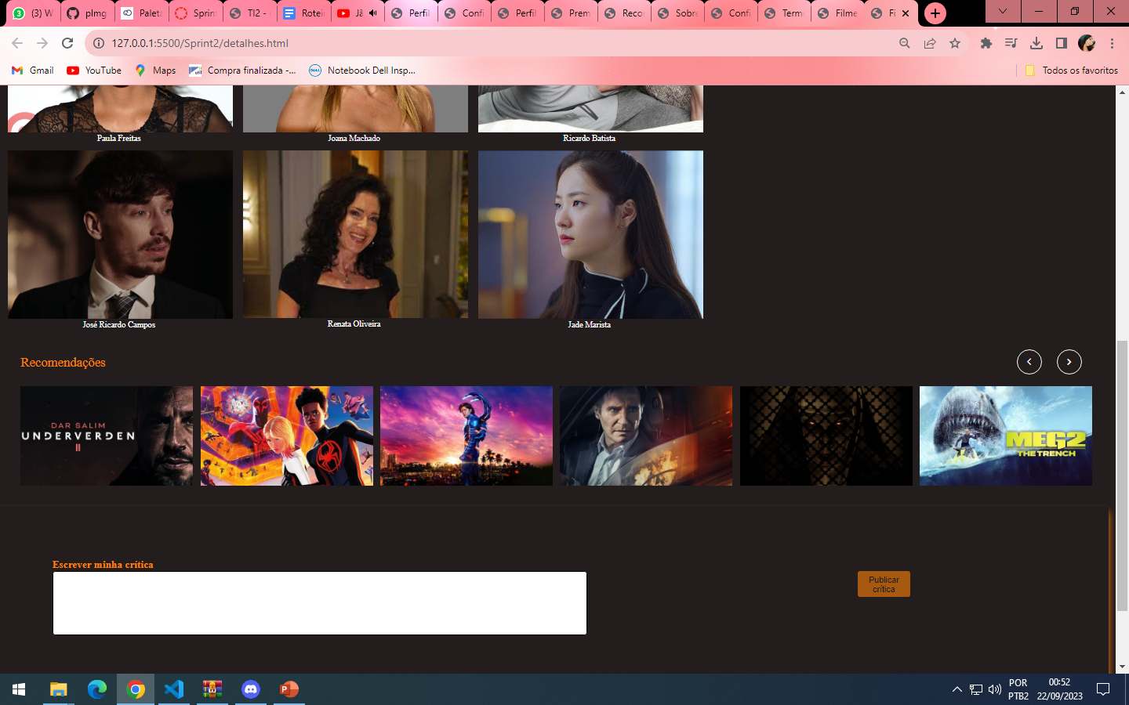
Home
About me
What I do
My experience
My work

Slide 16
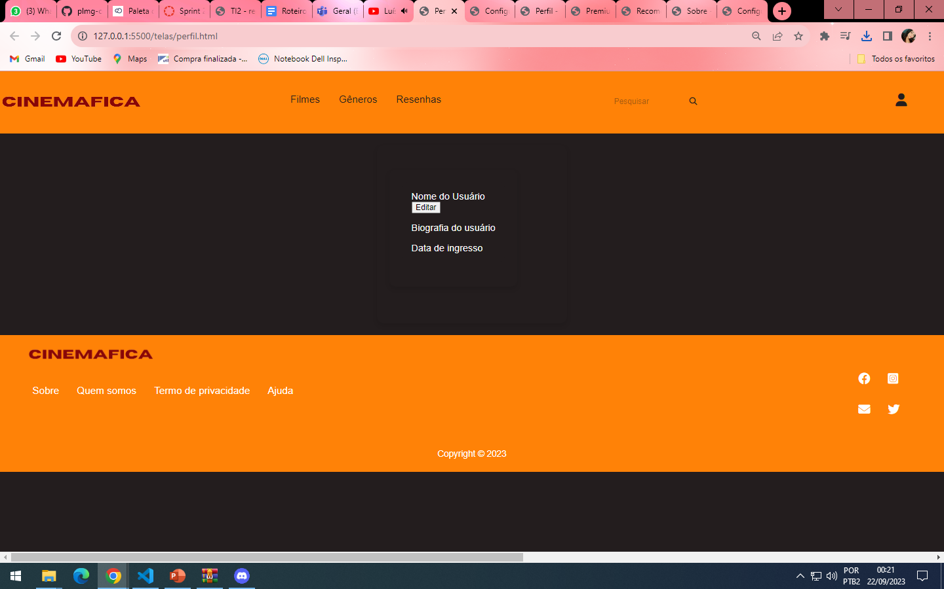
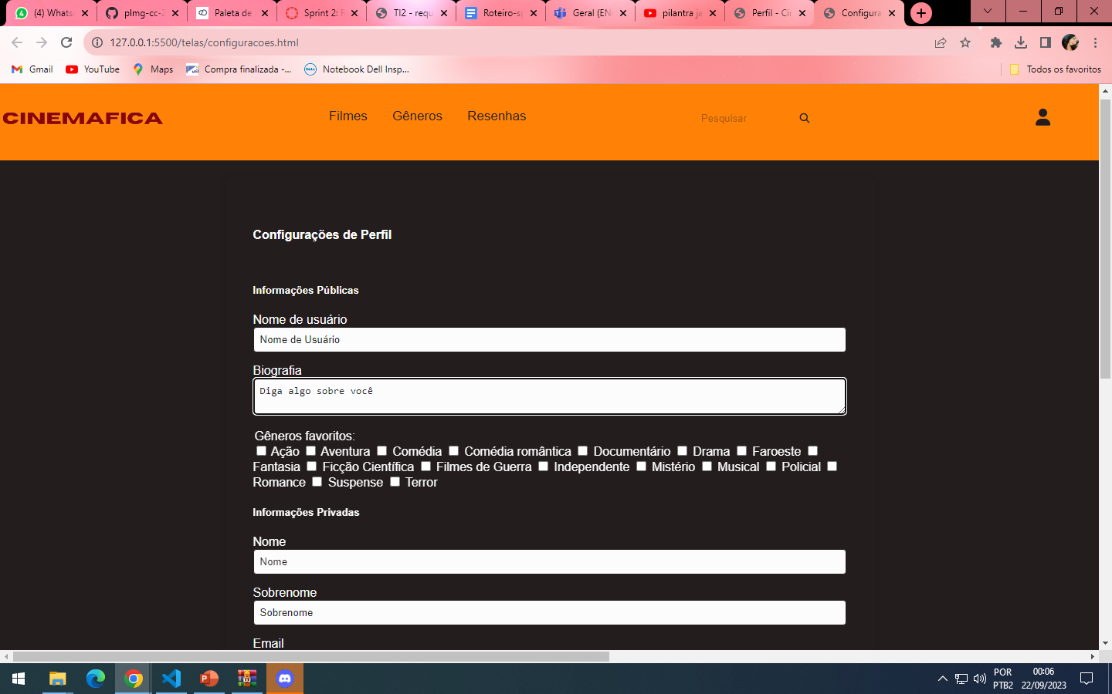
Home
About me
What I do
My experience
My work

Slide 17
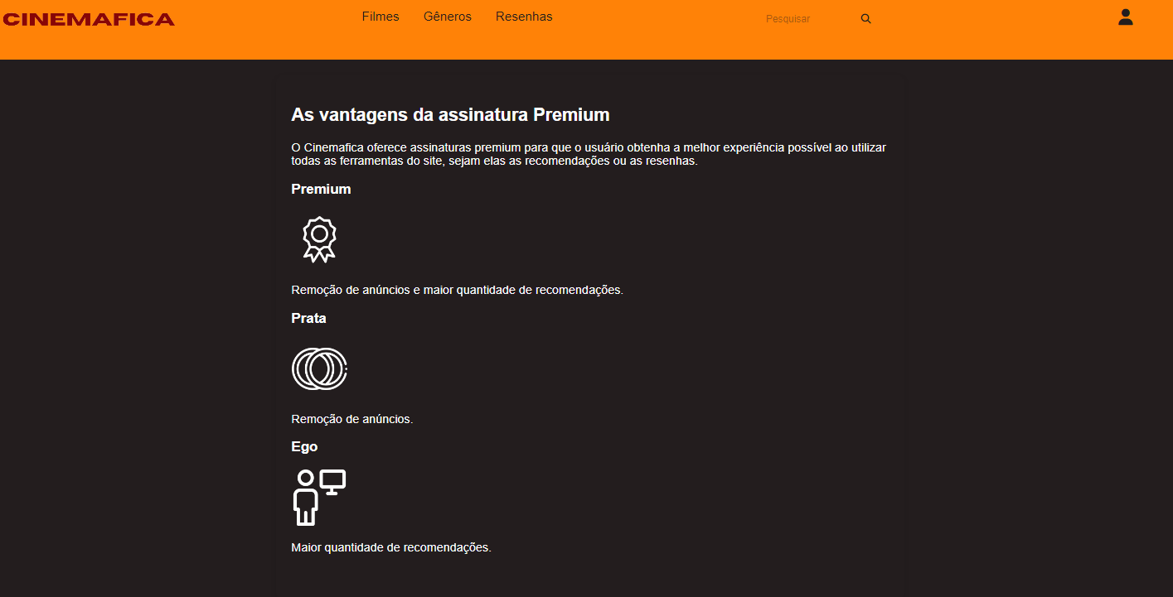
Home
About me
What I do
My experience
My work

Slide 18
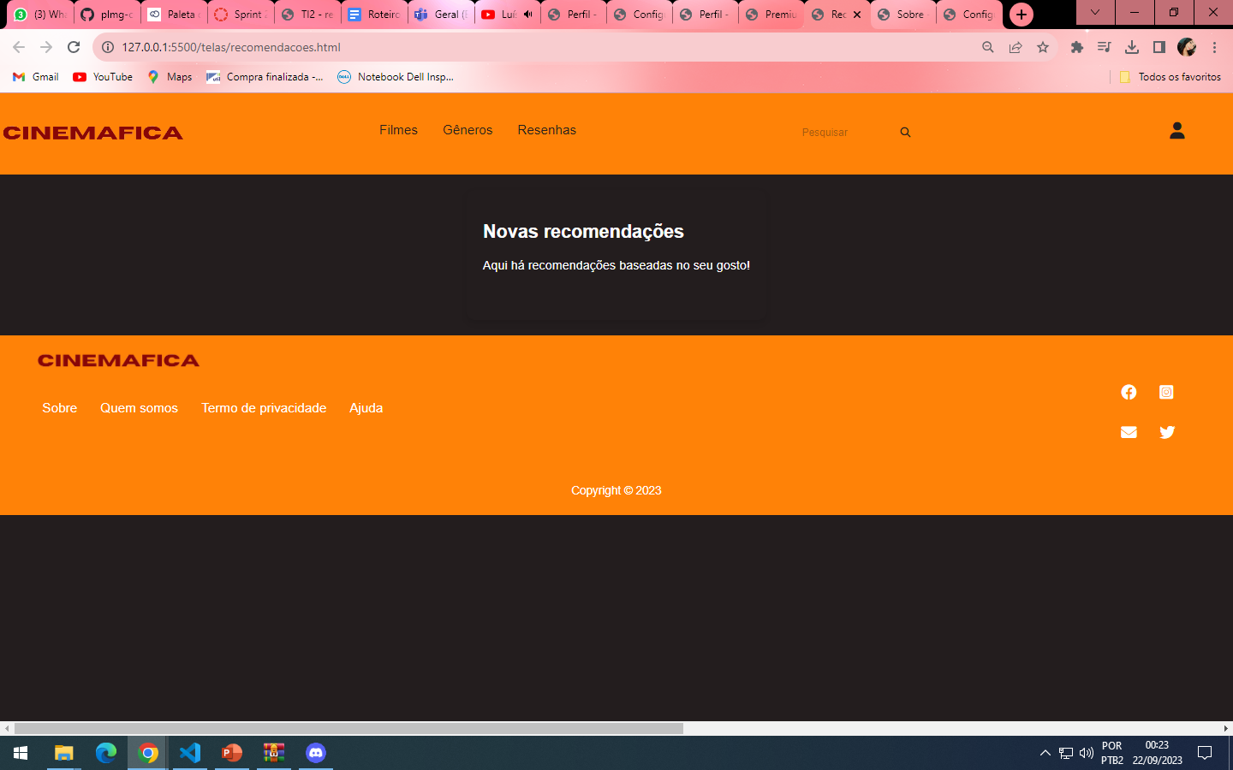
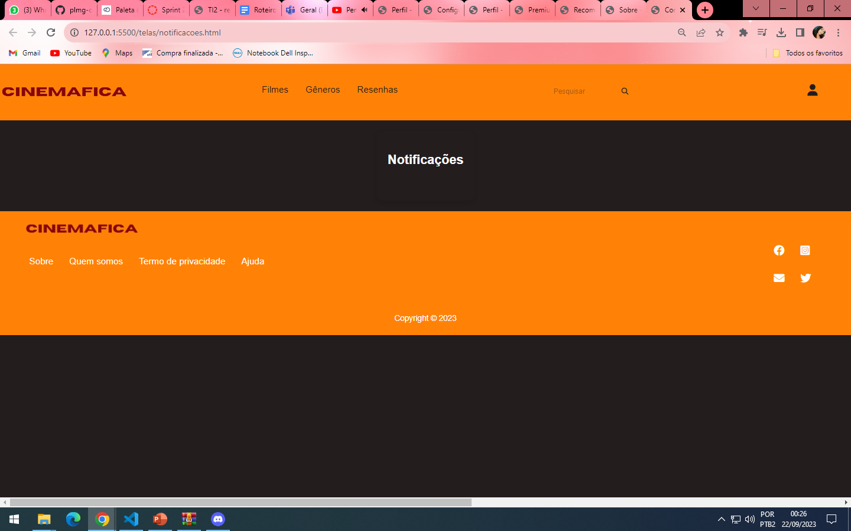
Home
About me
What I do
My experience
My work

Slide 19
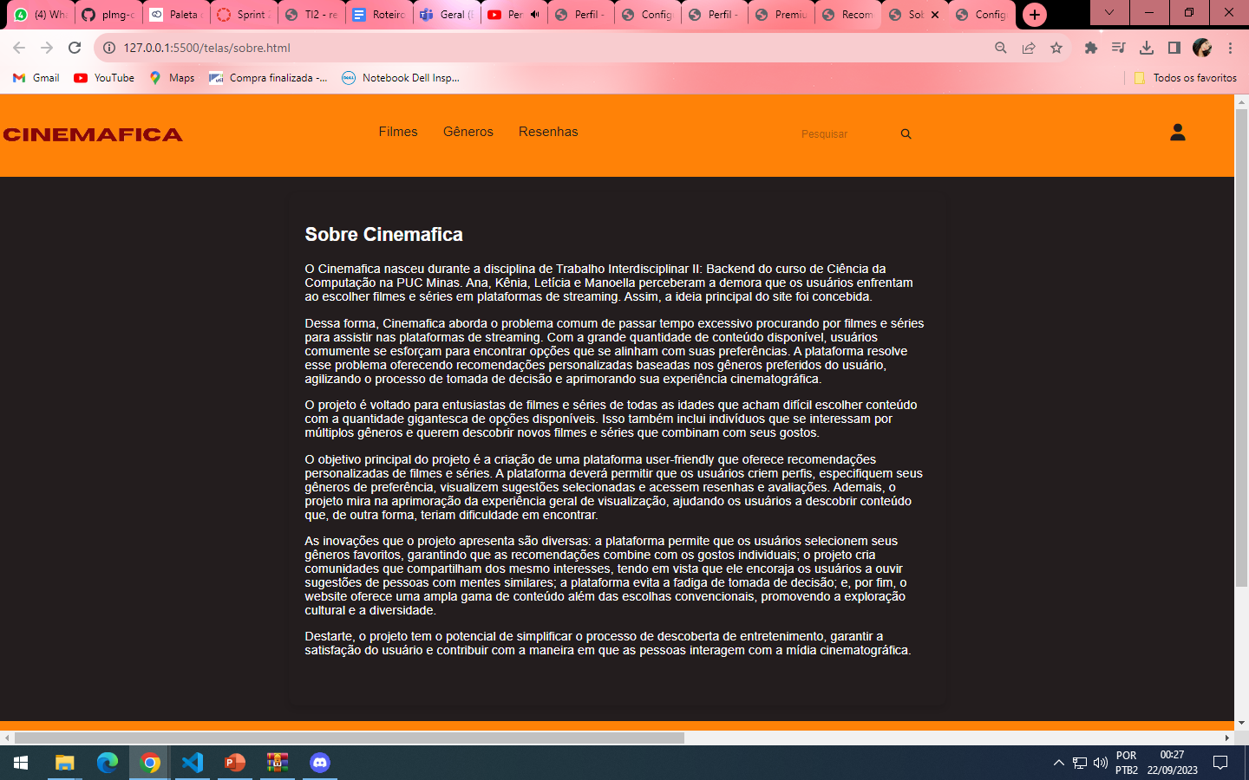
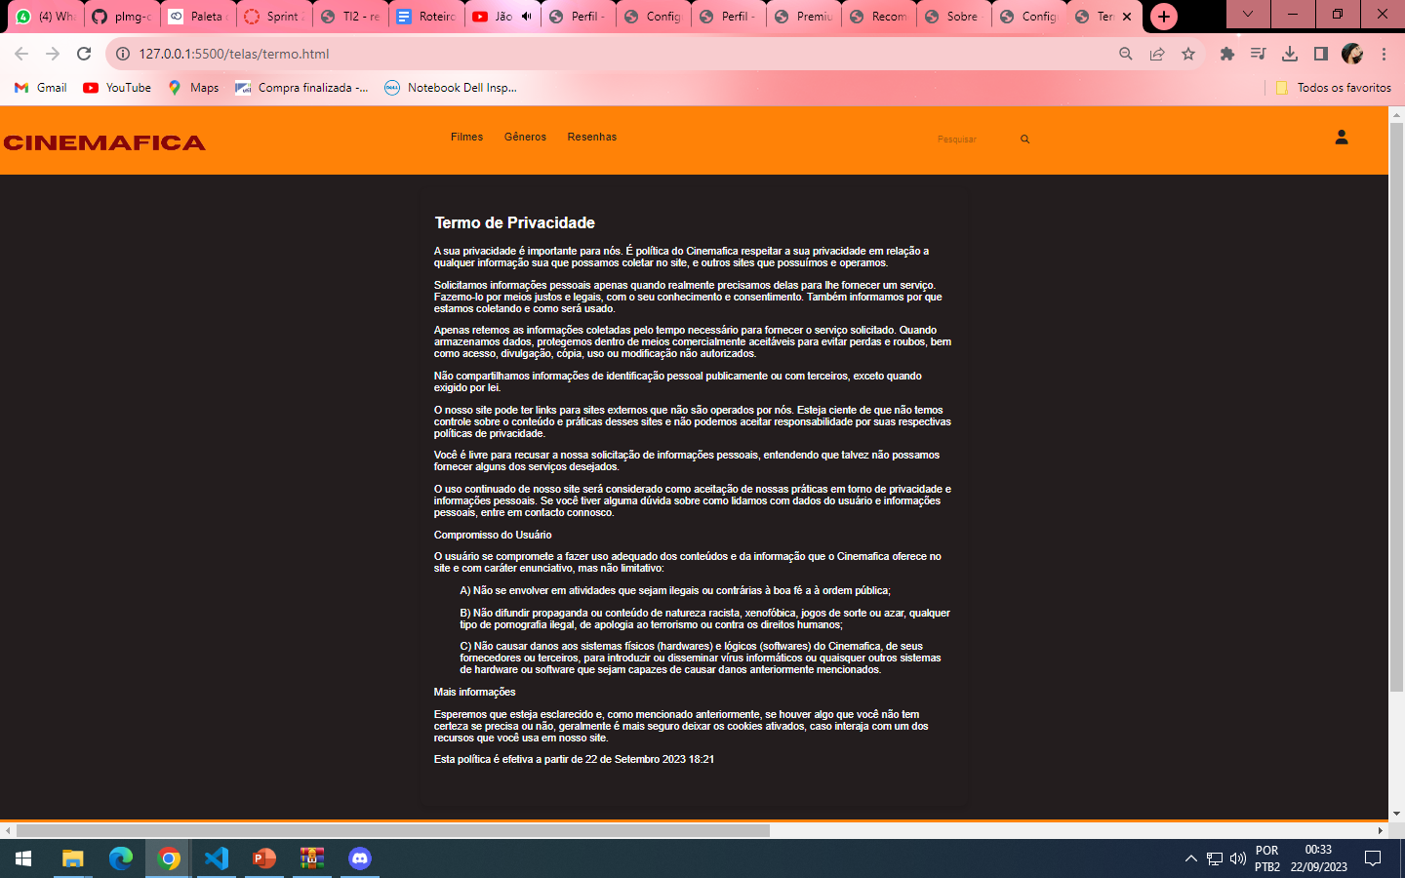
Home
About me
What I do
My experience
My work

Slide 20
OBRIGADA!
Home
About me
What I do
My experience
My work

